Slide 1
Shame, Attachment & Leadership
An examination of Brené Brown’s Dare to Lead

Slide 2
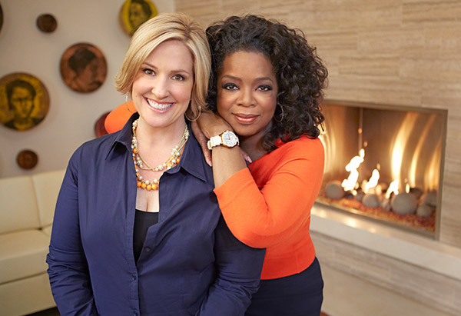

Brené Brown
Notes:
Brené Brown is a professor, lecturer, podcast host and storyteller. In 2010, Brown was propelled to superstardom through her viral TEDx talk, The Power of Vulnerability, which has since been viewed almost 54 million times (Brown, 2010). Her research centers around the topics of shame, empathy and vulnerability. Her books, The Gifts of Imperfection, Daring Greatly, Rising Strong, Braving the Wilderness and Dare to Lead are all #1 New York Times bestsellers. In Dare to Lead, Brené Brown advocates for utilizing the power of emotional vulnerability in the work environment.
Pugliese, J. (2013). Brene Brown and Oprah Winfrey. Brene Brown Interviewed by Oprah - Daring Greatly. Oprah.com.
Brown, B. (2018). Dare to Lead Book Cover. Amazon. https://www.amazon.com/Dare-Lead-Brave-Conversations-Hearts/dp/0399592520/ref=tmm_hrd_swatch_0?_encoding=UTF8&qid=1625174542&sr=8-1.

Slide 3
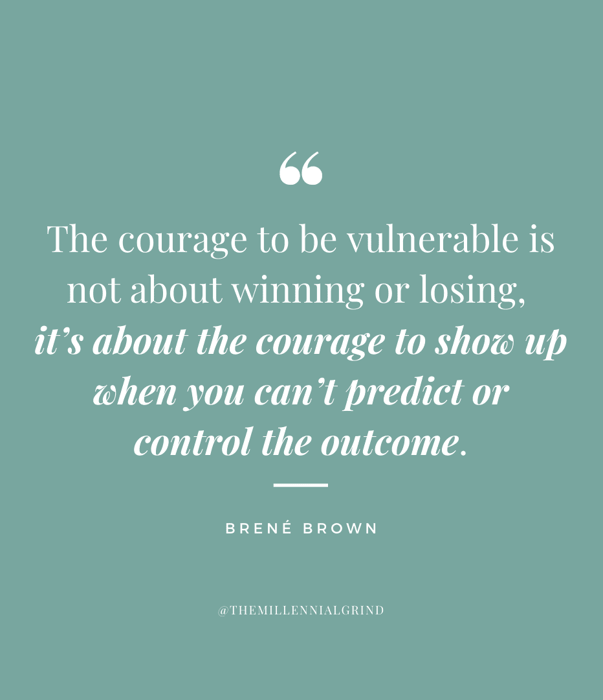
Brené Brown
Notes:
Brené Brown is a professor, lecturer, podcast host and storyteller. In 2010, Brown was propelled to superstardom through her viral TEDx talk, The Power of Vulnerability, which has since been viewed almost 54 million times (Brown, 2010). Her research centers around the topics of shame, empathy and vulnerability. Her books, The Gifts of Imperfection, Daring Greatly, Rising Strong, Braving the Wilderness and Dare to Lead are all #1 New York Times bestsellers. In Dare to Lead, Brené Brown advocates for utilizing the power of emotional vulnerability in the work environment.
Pugliese, J. (2013). Brene Brown and Oprah Winfrey. Brene Brown Interviewed by Oprah - Daring Greatly. Oprah.com.
Brown, B. (2018). Dare to Lead Book Cover. Amazon. https://www.amazon.com/Dare-Lead-Brave-Conversations-Hearts/dp/0399592520/ref=tmm_hrd_swatch_0?_encoding=UTF8&qid=1625174542&sr=8-1.
Wong, K. (2021, May 6). 40 Empowering Quotes from Dare to Lead by Brené Brown. THE MILLENNIAL GRIND. https://millennial-grind.com/40-empowering-quotes-from-dare-to-lead-by-brene-brown/.

Slide 4
Shame & Guilt
Guilt
Motivates repair
“I did a bad thing.”
Shame
Motivates avoidance
“I am a bad person.”

Slide 5
Shame Based Workplace Culture
Shame is systemic.
Complicity is part of the culture.
Money and power trump ethics.
Accountability is dead.
Control and fear are management tools.
And there’s a trail of devastation and pain.
(Brown, 2018, p.135)

Slide 6
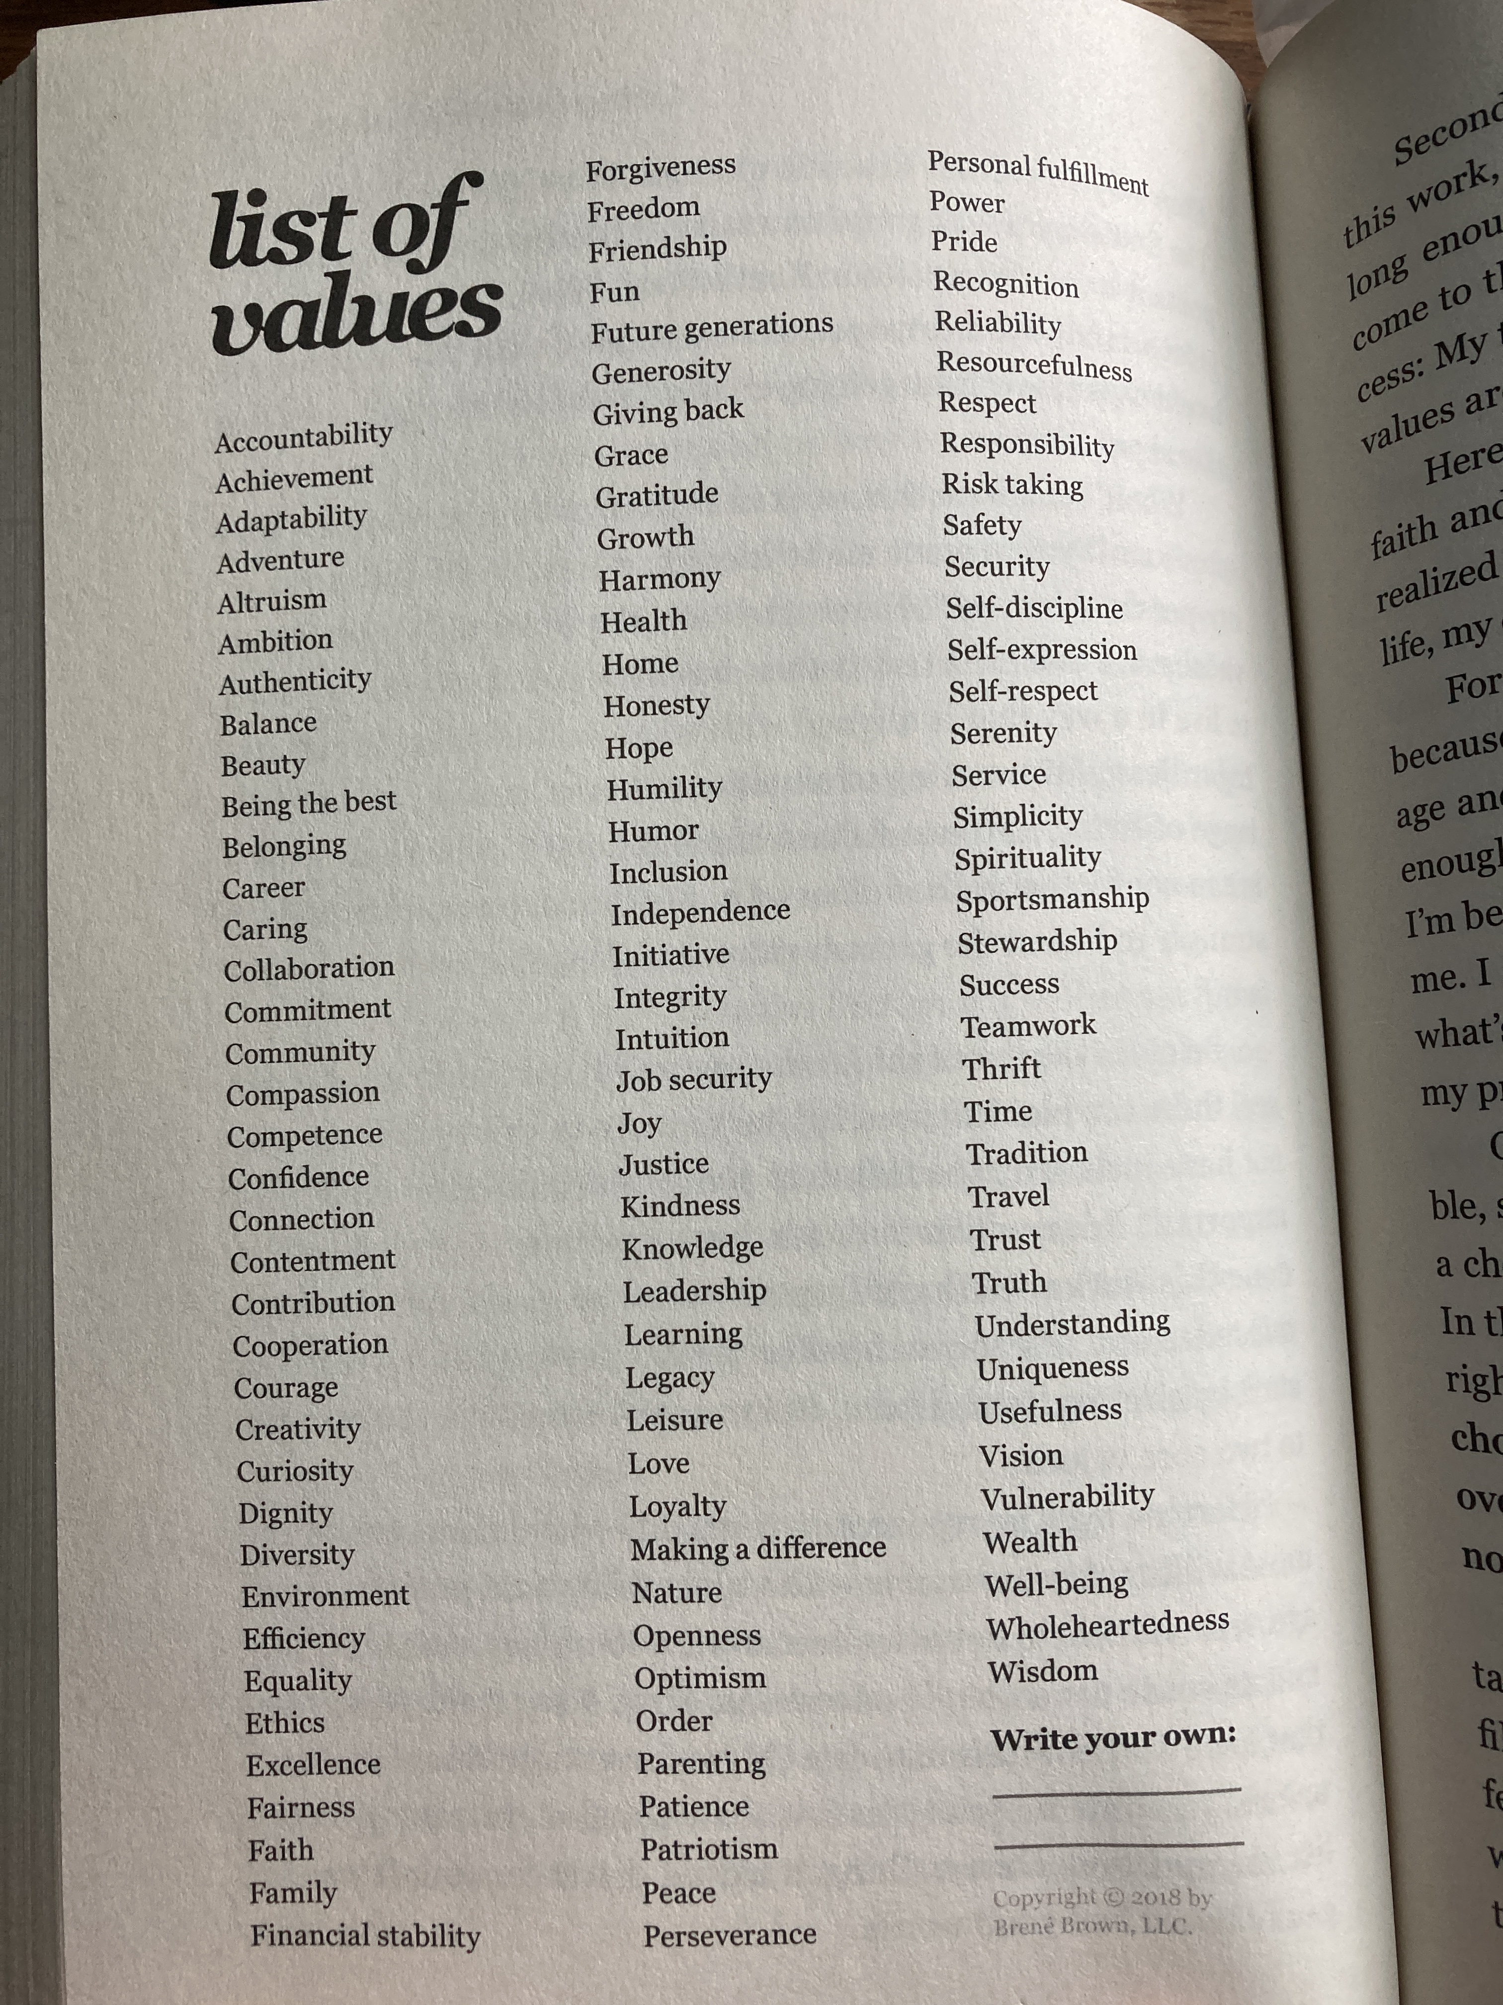
(Brown, 2018, p.188)

Slide 7
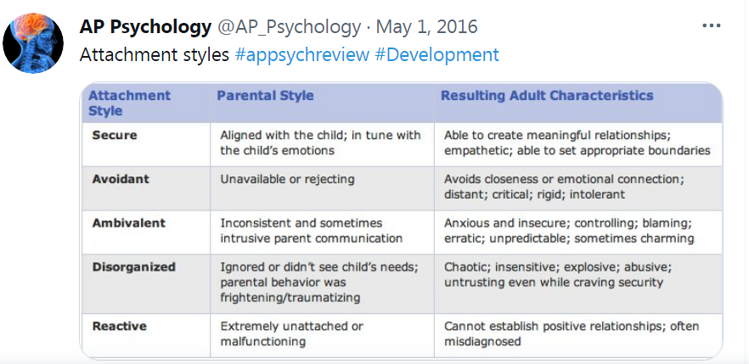
Anxious
Notes:
AP Psychology [@AP_Psychology]. (2016, May 1). Attachment styles #appsychreview #Development. https://twitter.com/ap_psychology/status/726892000478433280

Slide 8
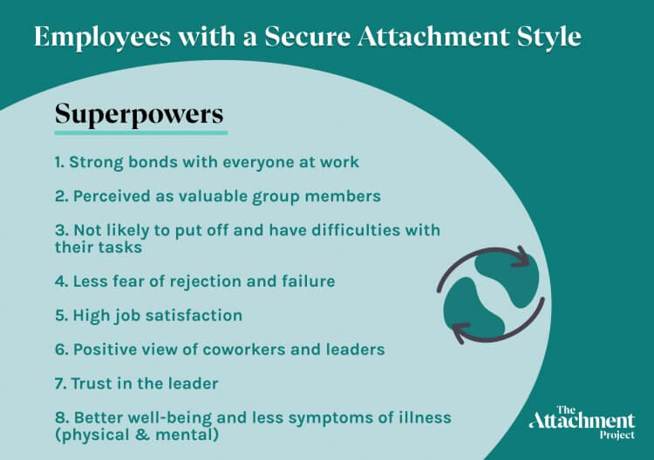

Slide 9
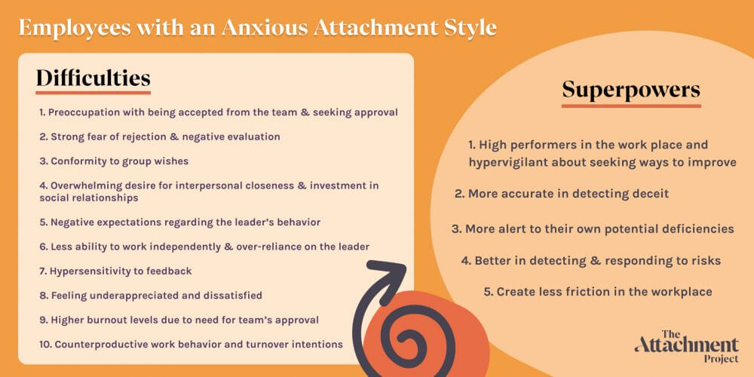

Slide 10
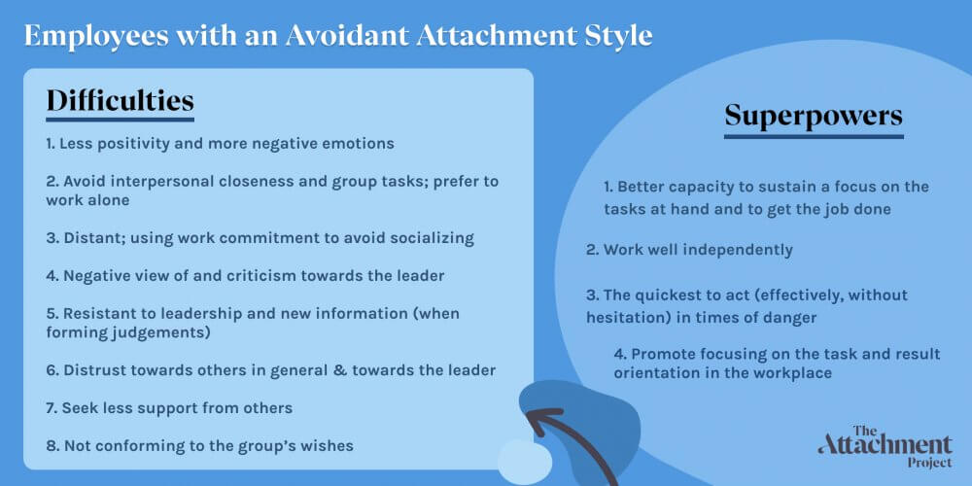

Slide 11
Empathic Skills + Trust +
Emotional Health = Secure
Ideally, should we seek a workplace full of secure individuals?

Slide 12
No!
Teams made up of secure, anxious, and avoidant individuals were correlated with better task performance when team cohesion was high (Lavy et al. 2014)

Slide 13
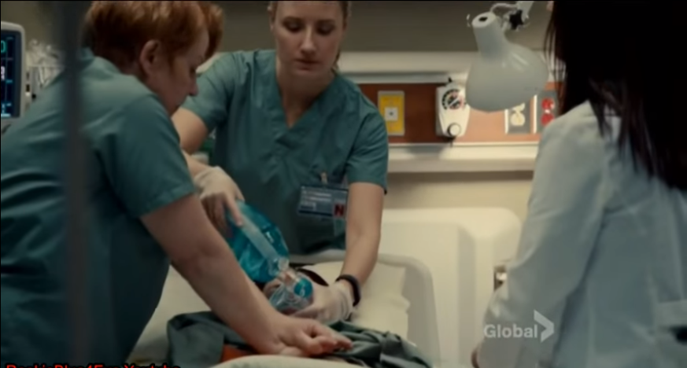
Notes:
A patient in her hospital bed stops breathing. One nurse calls a code. Another nurse beside her runs into the hallway and yells at the first staff member he sees, “Gonna need a crash cart. Call a crash cart right now.”
“On it,” she responds.
Medical staff rush into the room where the first nurse is already performing chest compressions. The doctor takes the lead saying, “Pulse less v-tach. Let’s get ready to shock. Give me 150 joules biphasic.”
A nurse picks up the defibrillator paddles. “Everyone clear? Everyone clear?”
Thump!
The monitors beep furiously.
“Her heart rate is rising above 200,” says a resident.
“We’re going again,” the doctor calls. “Wait a sec. Let’s rumble with this. How are you all feeling right now? Let’s all write down on a piece of paper what we are most afraid of and give ourselves permission to acknowledge that fear, and act courageously and imperfectly.”
Cameron, T. (2015). ~* Rookie Blue Season 5 Episode 1 - Chloe Hospital Scenes Part 3 *~. YouTube. YouTube. https://www.youtube.com/watch?v=uvqsey9xTsY.

Slide 14


Slide 15
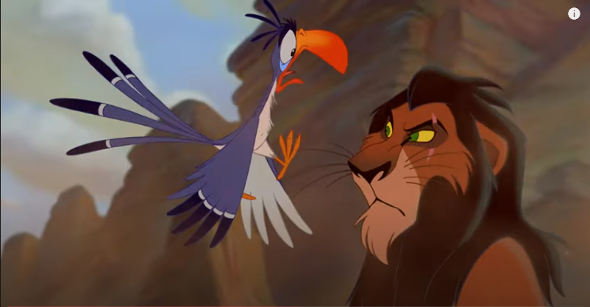
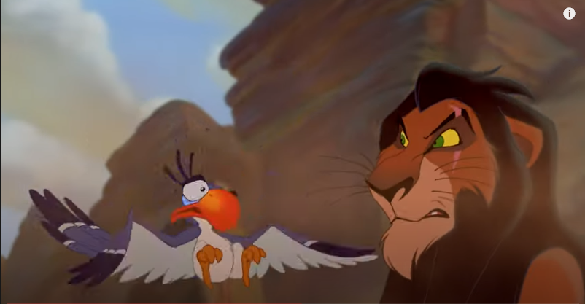
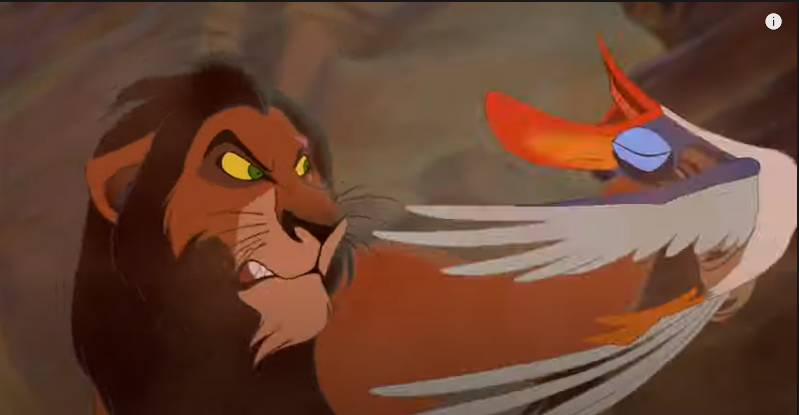
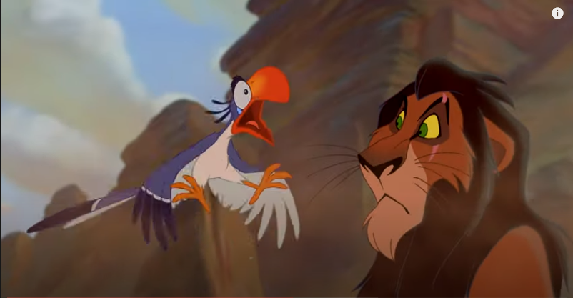
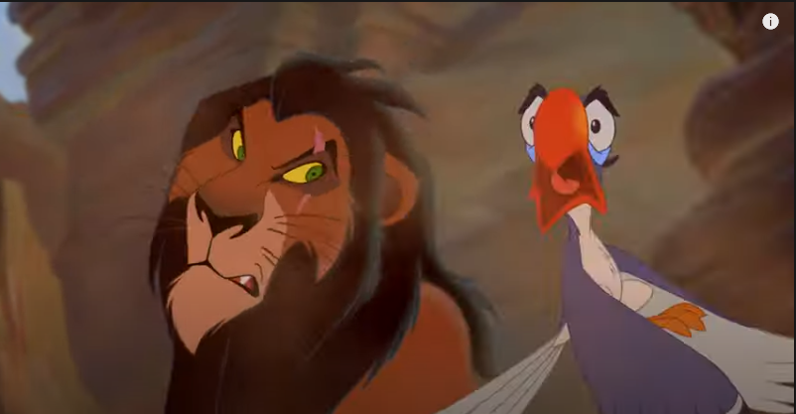
Notes:
Hahn, D., Mecchi, I., Roberts, J., & Woolverton, L. (2020). The Lion King (1994) - Stampede [4K]. YouTube. YouTube. https://www.youtube.com/watch?v=x__EVvWUT3A.

Slide 16
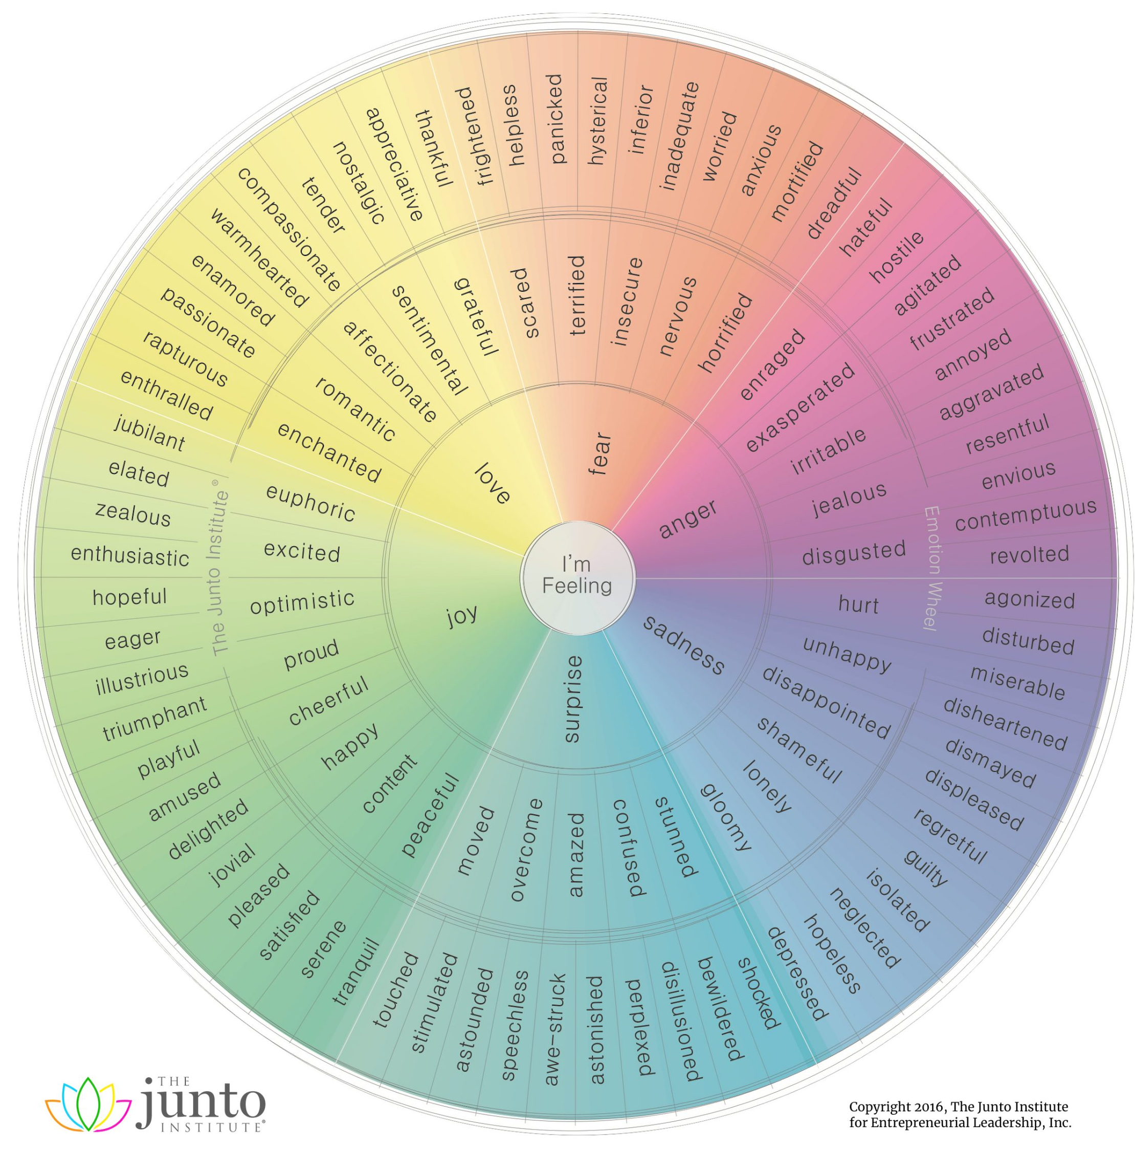

Slide 17
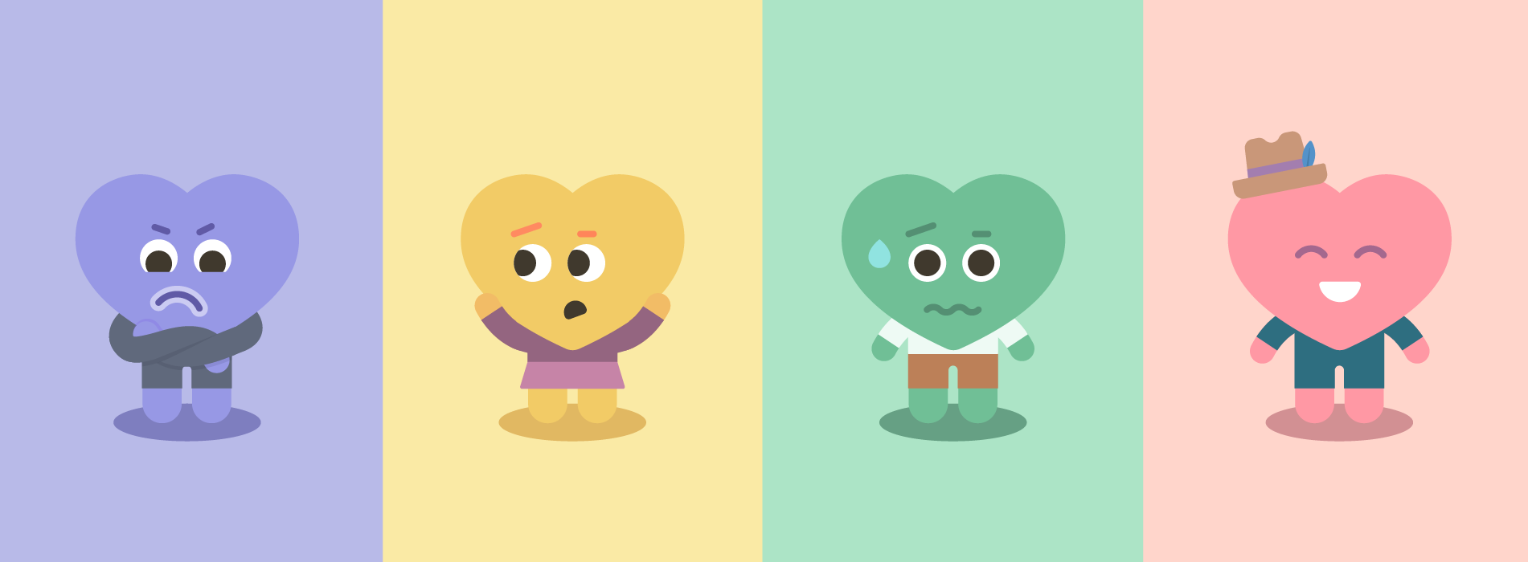
Learning is possible!

Slide 18
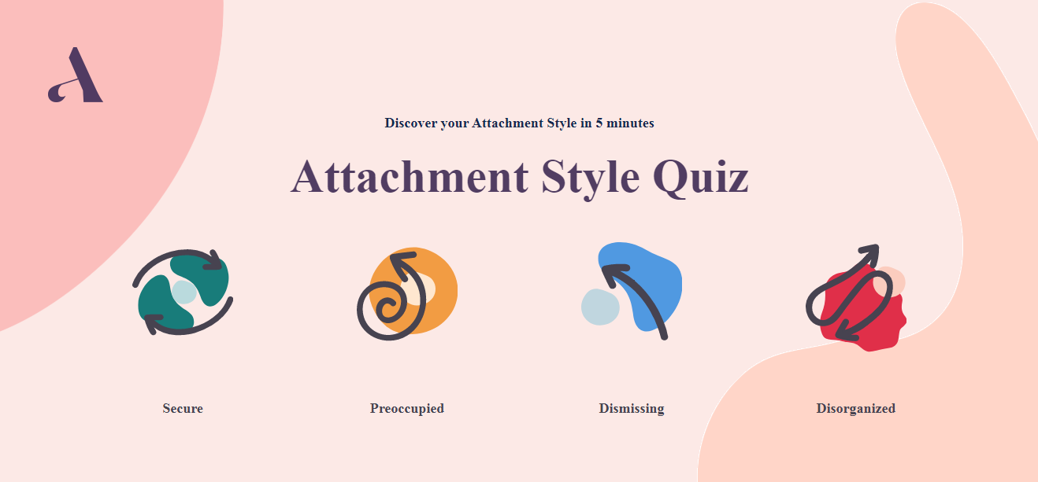
https://quiz.attachmentproject.com/

Slide 19
References
Anurajan, R. S. (2020). Mm Headerimage 5-1. Dangit. https://dangit.in/featured/attachment-vs-detachment/.
AP Psychology [@AP_Psychology]. (2016, May 1). Attachment styles #appsychreview #Development. https://twitter.com/ap_psychology/status/726892000478433280
The Attachment Project. (2020). Attachment Style Quiz. The Attachment Project | Testing Platform. https://quiz.attachmentproject.com/.
The Attachment Project. (2020). Anxious Preoccupied Attachment in the Workplace. Here's How Your Attachment Style Impacts You At Work [Pros & Cons]. The Attachment Project. https://www.attachmentproject.com/blog/attachment-in-the- workplace/.
The Attachment Project. (2020). Avoidant Attachment in the Workplace. Here's How Your Attachment Style Impacts You At Work [Pros & Cons]. The Attachment Project. https://www.attachmentproject.com/blog/attachment-in-the-workplace/.

Slide 20
References
The Attachment Project. (2020). Secure Attachment in the Workplace. Here's How Your Attachment Style Impacts You At Work [Pros & Cons]. The
Attachment Project. https://www.attachmentproject.com/blog/attachment-in- the-workplace/.
Brown Brené. (2018). Dare to Lead. Random House.
Brown, B. (2018). Dare to Lead Book Cover. Amazon. https://www.amazon.com/Dare-Lead-Brave-Conversations- Hearts/dp/0399592520/ref=tmm_hrd_swatch_0?_encoding=UTF8&qid=1625174 542&sr=8-1.
Cameron, T. (2015). ~* Rookie Blue Season 5 Episode 1 - Chloe Hospital Scenes Part 3 *~. YouTube. YouTube. https://www.youtube.com/watch?v=uvqsey9xTsY.
Hahn, D., Mecchi, I., Roberts, J., & Woolverton, L. (2020). The Lion King (1994) - Stampede [4K]. YouTube. YouTube. https://www.youtube.com/watch?v=x__EVvWUT3A.

Slide 21
References
The Junto Institute. (2016). Emotion Wheel Chart. Emotion Wheel Chart | The Junto Institute. https://www.thejuntoinstitute.com/emotion-wheels/.
Lavy, S., Bareli, Y., & Ein-Dor, T. (2014). The Effects of Attachment Heterogeneity and Team Cohesion on Team Functioning. Small Group Research, 46(1), 1-23. https://doi.org/DOI:10.1177/1046496414553854
Pugliese, J. (2013). Brene Brown and Oprah Winfrey. Brene Brown Interviewed by Oprah - Daring Greatly. Oprah.com.
Villines, Z. (2015). Therapist-comforting-person-in-therapy. BlogTherapy. Goodtherapy.org. https://www.goodtherapy.org/blog/can-a-computer- assess-quality-of-therapy-1209151.
Wong, K. (2021, May 6). 40 Empowering Quotes from Dare to Lead by Brené Brown. THE MILLENNIAL GRIND. https://millennial-grind.com/40- empowering-quotes-from-dare-to-lead-by-brene-brown/.

